Slide 1
CS 590 Algorithm
Chapter 3 Binary Search Trees
Source: Goodrich, M. T., & Tamassia, R. (2015). Algorithm Design and Applications. Hoboken, NJ: Wiley.

Slide 2
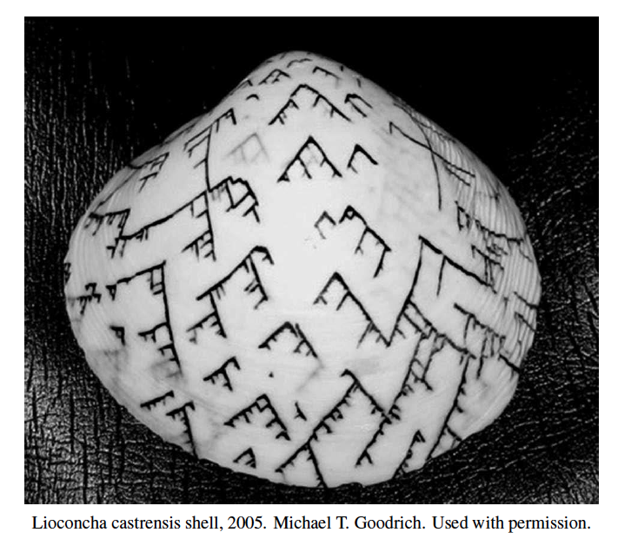
Binary Search Trees
Presentation for use with the textbook Algorithm Design and Applications, by M. T. Goodrich and R. Tamassia, Wiley, 2015

Slide 3
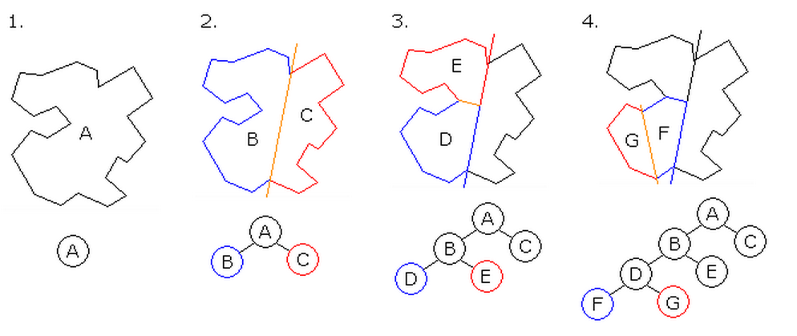
Application: Binary Space Partitioning
In three-dimensional video games and virtual environments, it is important to be able to locate objects relative to the other objects in their environment.
One way to do this is to use binary space partitioning.
To create such a partitioning, we identify a plane, P, that divides the set of objects into two groups of roughly equal size—those objects to the left of P and those objects to the right of P.
Then, for each group, we recursively subdivide them with other separating planes until the number of objects in each subgroup is small enough to handle as individuals.
Locating a point relative to others involves searching in this binary tree.
Binary space partitioning. Maksim, 2006. Public-domain image.

Slide 4
Binary Search
Binary search can perform nearest neighbor queries on an ordered map that is implemented with an array, sorted by key
similar to the high-low children’s game
at each step, the number of candidate items is halved
terminates after O(log n) steps
Example: find(7)
0
1
3
4
5
7
8
9
11
14
16
18
19
l
m
h
0
1
3
4
5
7
8
9
11
14
16
18
19
l
m
h
0
1
3
4
5
7
8
9
11
14
16
18
19
l
m
h
0
1
3
4
5
7
8
9
11
14
16
18
19
l=m =h

Slide 5
Search Tables
A search table is an ordered map implemented by means of a sorted sequence
We store the items in an array-based sequence, sorted by key
We use an external comparator for the keys
Performance:
Searches take O(log n) time, using binary search
Inserting a new item takes O(n) time, since in the worst case we have to shift n items to make room for the new item
Removing an item takes O(n) time, since in the worst case we have to shift n items to compact the items after the removal
The lookup table is effective only for ordered maps of small size or for maps on which searches are the most common operations, while insertions and removals are rarely performed.

Slide 6
Binary Search Trees
A binary search tree is a binary tree storing keys (or key-value entries) at its internal nodes and satisfying the following property:
Let u, v, and w be three nodes such that u is in the left subtree of v and w is in the right subtree of v. We have key(u) ≤ key(v) ≤ key(w)
External nodes do not store items
An inorder traversal of a binary search trees visits the keys in increasing order
6
2
9
1
4
8

Slide 7
Search
Algorithm TreeSearch(k, v)
if T.isExternal (v)
return v
if k < key(v)
return TreeSearch(k, leftChild(v))
else if k = key(v)
return v
else { k > key(v) }
return TreeSearch(k, rightChild(v))
To search for a key k, we trace a downward path starting at the root
The next node visited depends on the comparison of k with the key of the current node
If we reach a leaf, the key is not found
Example: get(4):
Call TreeSearch(4,root)
The algorithms for nearest neighbor queries are similar
<
6
2
>
9
1
4
=
8

Slide 8
Insertion
<
6
To perform operation put(k, o), we search for key k (using TreeSearch)
Assume k is not already in the tree, and let w be the leaf reached by the search
We insert k at node w and expand w into an internal node
Example: insert 5
2
>
9
1
4
>
8
w
6
2
9
1
4
8
w
5

Slide 9
Deletion
To perform operation remove(k), we search for key k
Assume key k is in the tree, and let v be the node storing k
If node v has a leaf child w, we remove v and w from the tree with operation removeExternal(w), which removes w and its parent
Example: remove 4
<
6
2
>
9
1
4
v
8
w
5
6
2
9
1
5
8

Slide 10
Deletion (cont.)
1
v
We consider the case where the key k to be removed is stored at a node v whose children are both internal
We find the internal node w that follows v in an inorder traversal
We copy key(w) into node v
We remove node w and its left child z (which must be a leaf) by means of operation removeExternal(z)
Example: remove 3
3
2
8
6
9
w
5
z
1
v
5
2
8
6
9

Slide 11
Performance
Consider an ordered map with n items implemented by means of a binary search tree of height h
the space used is O(n)
methods get, put and remove take O(h) time
The height h is O(n) in the worst case and O(log n) in the best case

Slide 12
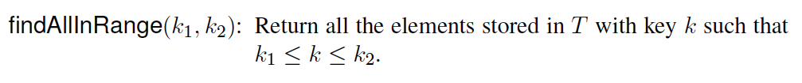
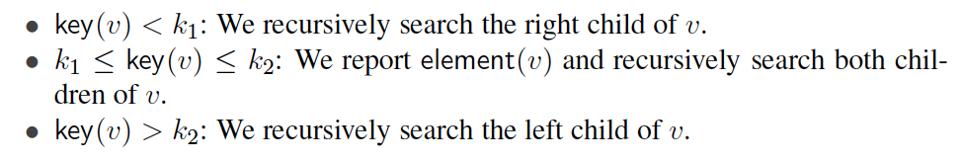
Range Queries
An additional operation that can be answered by a binary search tree is a range query:
Example: Find all cars on eBay priced between $10,000 and $15,000.
Algorithm:

Slide 13
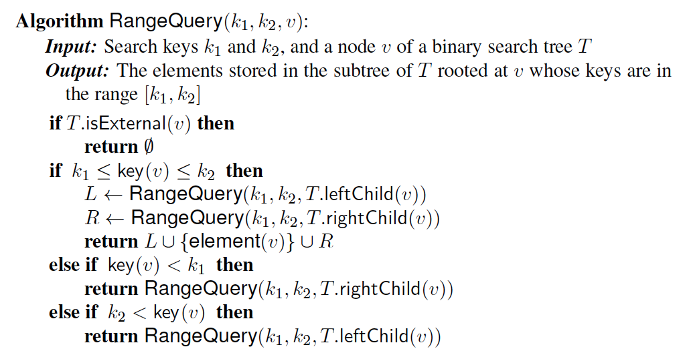
Pseudo-code
Range-query algorithm:

Slide 14
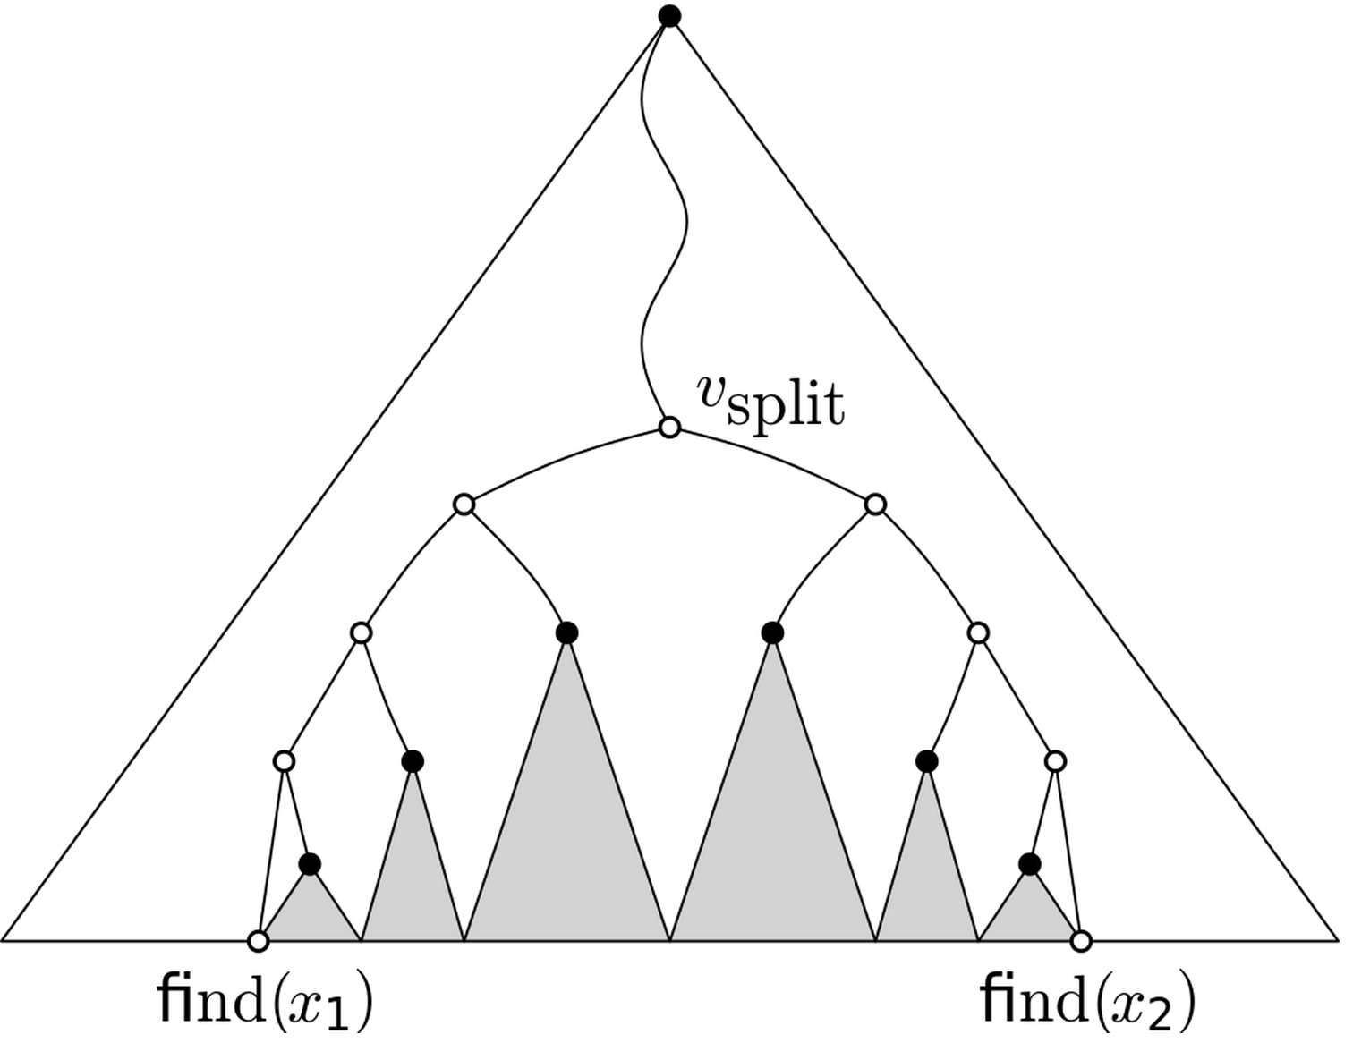
Visualization
Drawing subtrees as triangles, then we visit all the shaded subtrees.
A range query on a 1-dimensional range tree.
Magnus Manske, 2012. Public-domain image.

Slide 15
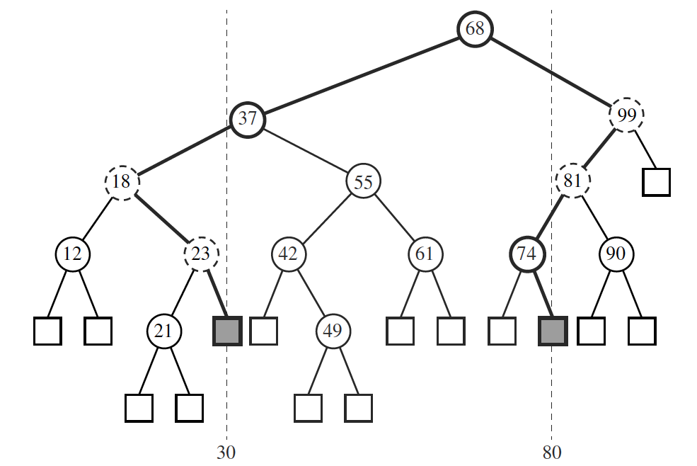
Example
An example shows that we also need to test for the nodes we visit along the search paths for k₁ and k₂.

Slide 16
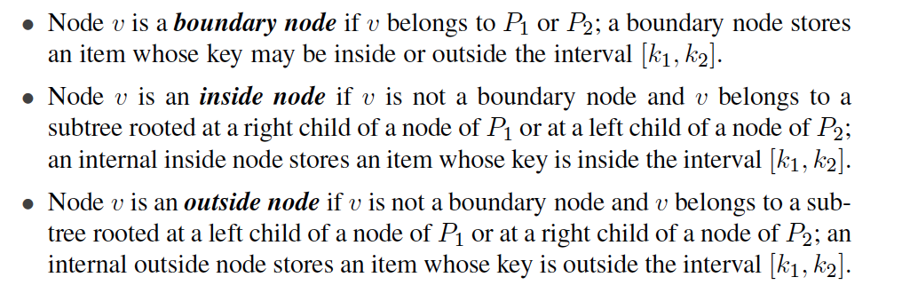
Types of Nodes that We Visit
Types of notes that we visit:
Let P₁ be the path from the root to k₁.
Let P₂ be the path from the root to k₂.

Slide 17
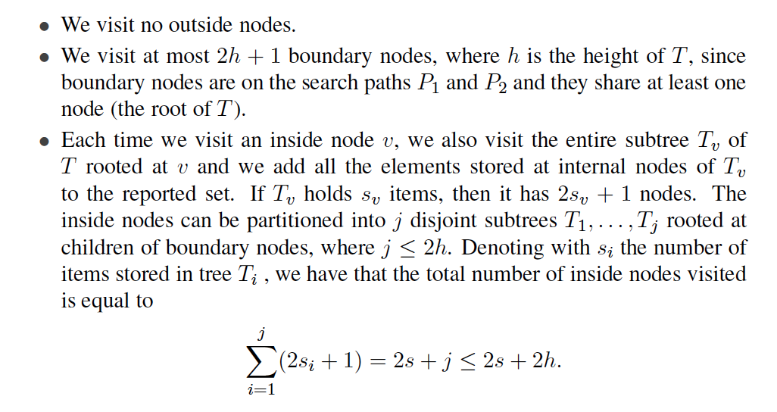
Performance
Let h denote the height of the binary search tree, T, and let s be the number of elements in the range.
Therefore, at most 2s + 4h + 1 nodes of T are visited and the operation findAllInRange runs in O(h + s) time.

Slide 18
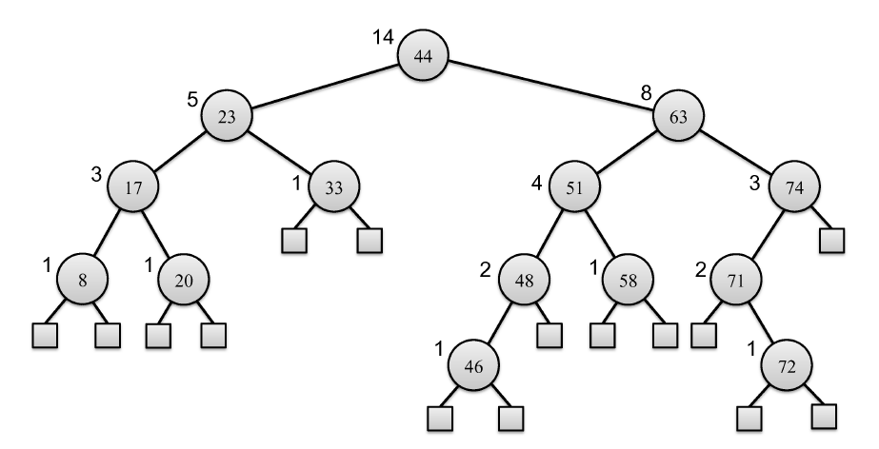
Index-Based Searching
We want to use BST (instead of a sorted array) to find the ith smallest item. Because arrays do not support efficient insertion and deletion.
Add a new operation:
select(i): Return the item with i-th smallest key, for 1 ≤ i ≤ n.
Main idea to support this new method:
Augment each node v to store n_{v}, the number of elements in the subtree rooted at v.

Slide 19
Maintaining the New Fields
We must now update n_{v} fields when we do an insertion or deletion.
If we are doing an insertion at a node, w, in T (which was previously an external node), then we set n_{w} = 1 and we increment the n_{v} count for each node v that is an ancestor of w, that is, on the path from w to the root of T.
If we are doing a deletion at a node, w, in T, then we decrement the n_{v} count for each node v that is on the path from w’s parent to the root of T.

Slide 20
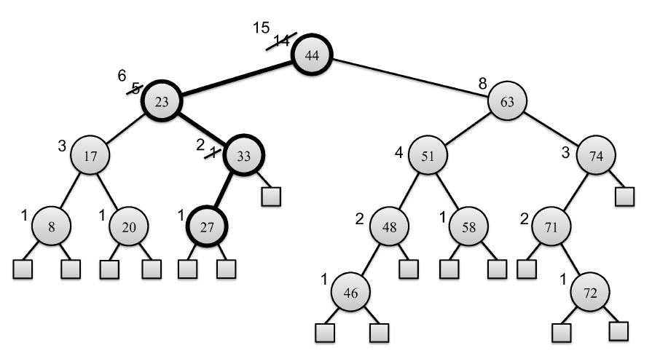
Insertion Update Example
Updating the counts for inserting an element with key 27.

Slide 21
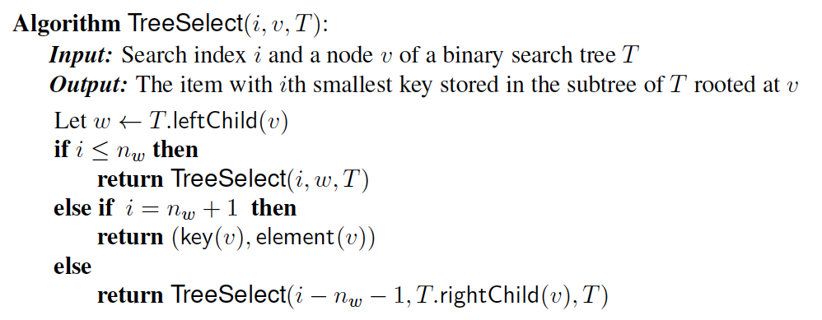
Search Algorithm
We can do a search based on the rank, i, for the i-th smallest element.
We call TreeSelect(i, r, T) below where r is the root.

Slide 22
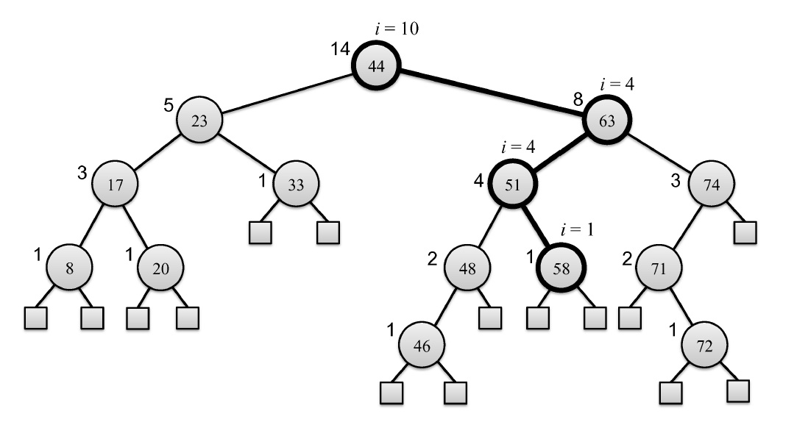
Example
A search for the 10th smallest element.

Slide 23
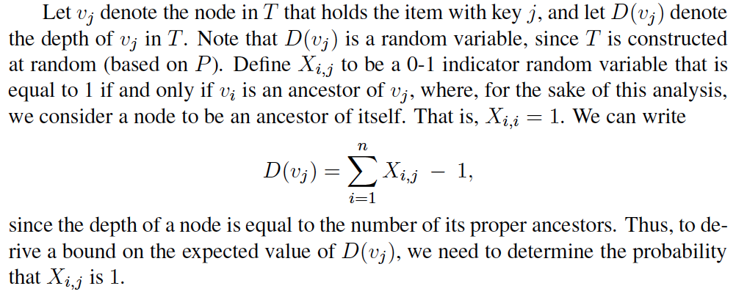
Randomly Constructed Binary Search Trees
Suppose we construct a binary search tree, T, by a sequence of insertions of n distinct, random keys.
Since the only thing that impacts the structure of T is the relative order of the keys, we can assume, without loss of generality, that the keys involved are the integers from 1 to n, given as a random permutation, P.

Slide 24
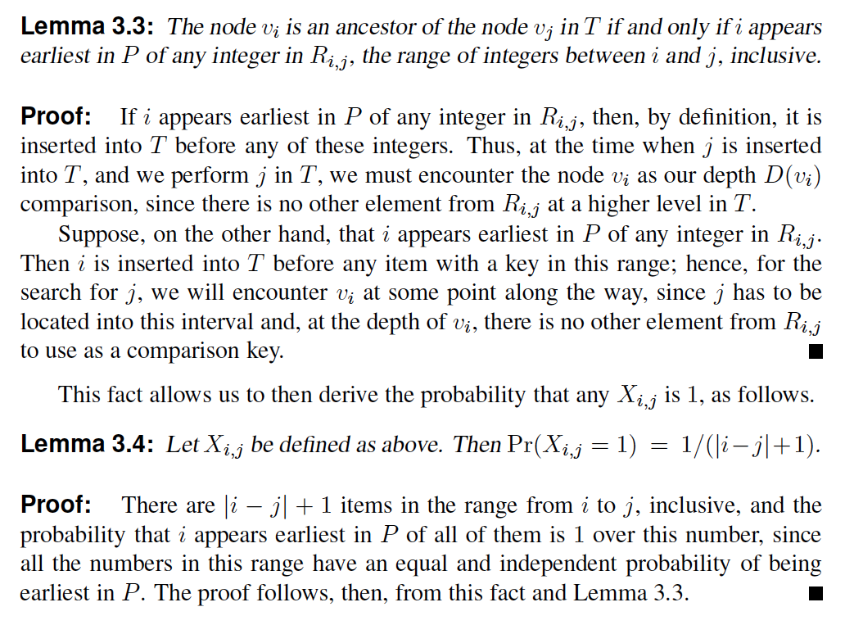
Important Lemmas

Slide 25
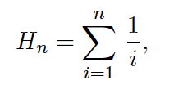
Harmonic Numbers
For any integer n ≥ 1, we define the nth harmonic number, H_{n}, as
It is well-known that H_{n} is O(log n).
Hint: If you know calculus, bound the above summation with a definite integral and solve it.

Slide 26
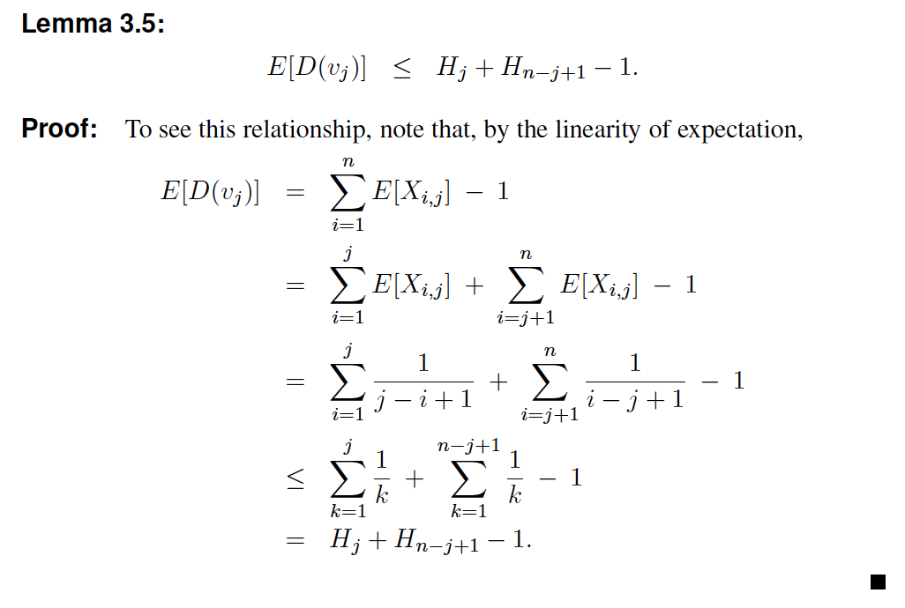
Expected Depth
The expected depth of any node is O(log n):

Slide 27
Probability of the Depth
Theorem 3.6: If T is a randomly constructed binary search tree with n > 4 nodes, then the height of T is O(log n) with probability at least 1 − 1/n
Proof: See Page 109. Uses e Chernoff bound
So, if we construct a binary search tree, T , by inserting a set of n distinct items in random order, then, with high probability, the height of T will be O(log n)

Slide 28
About Stevens
A premier, private research university with a mission to inspire, nurture and educate leaders in tomorrow’s technology-centric environment while contributing to the solution of the most challenging problems of our time

